Slide 1
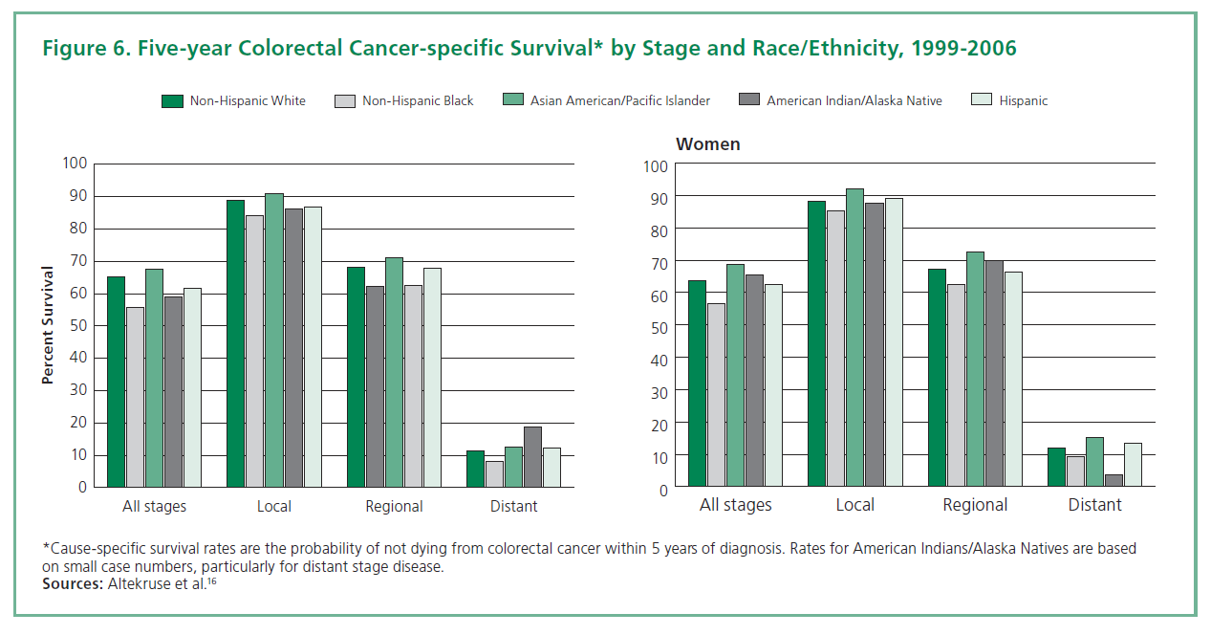
Colon Cancer Risk Reduction

Slide 2
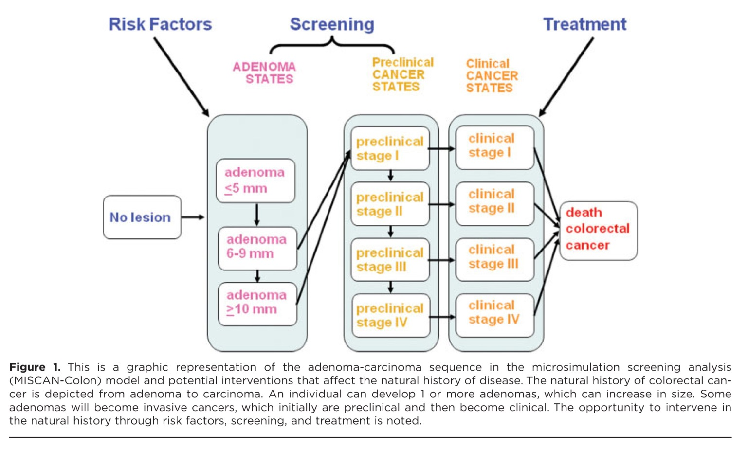
The Polyp to Cancer Sequence

Slide 4
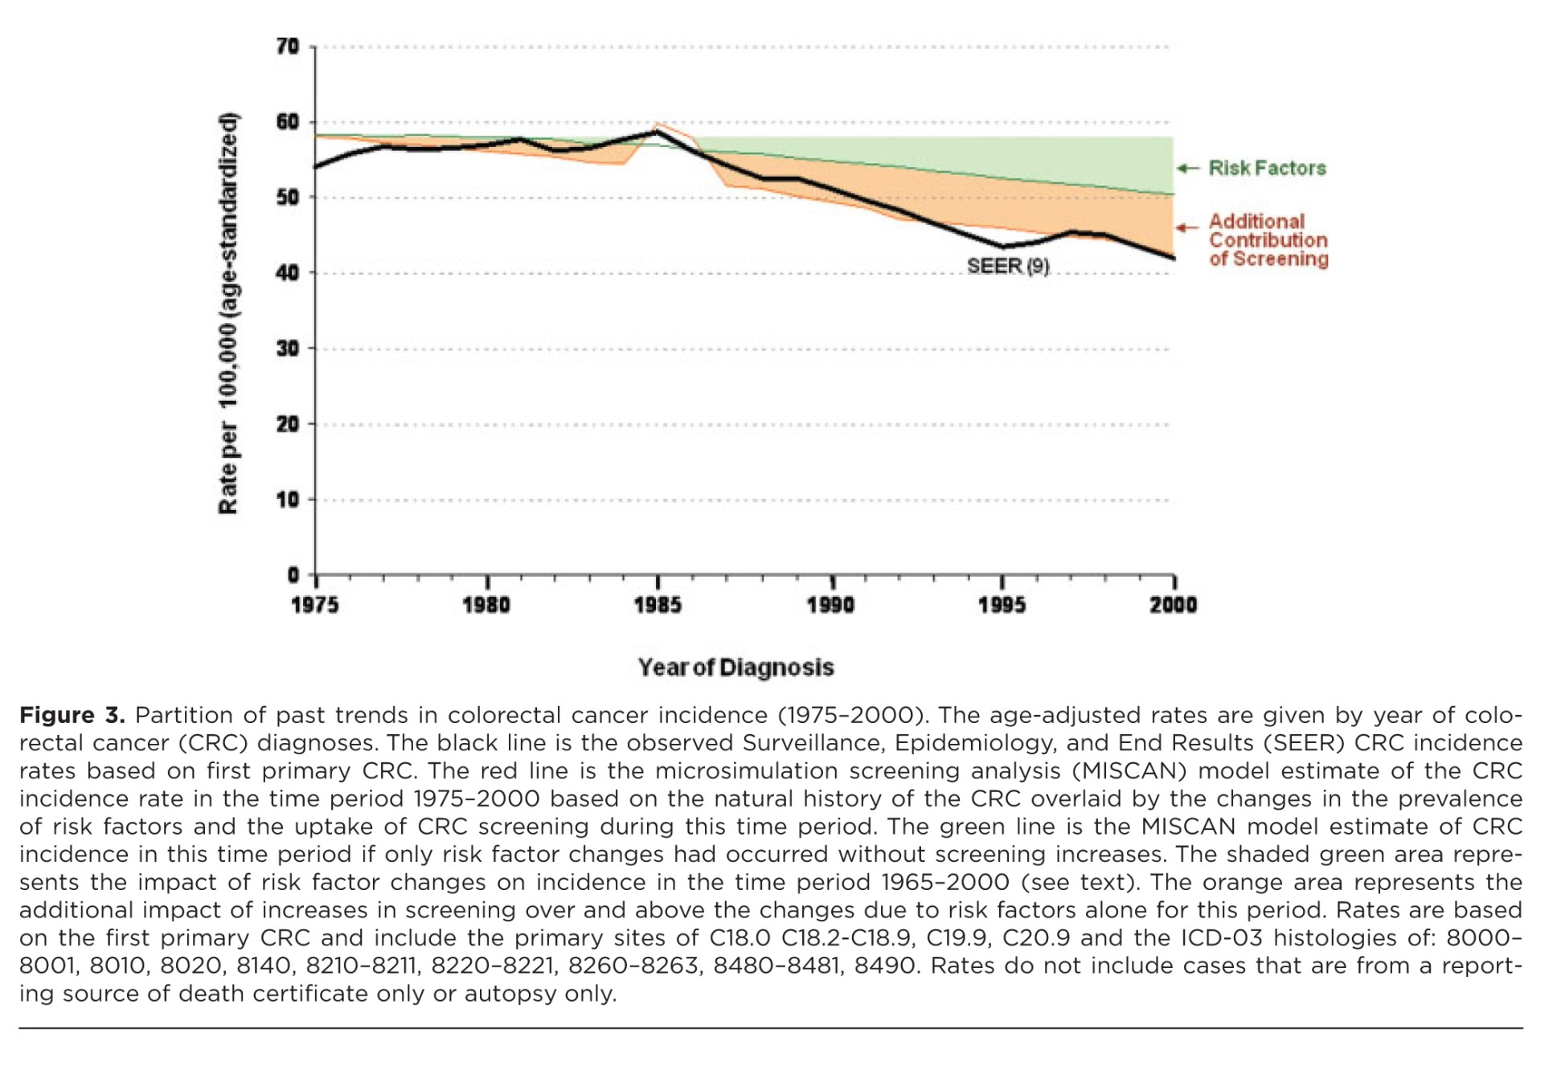
CRC Incidence

Slide 5
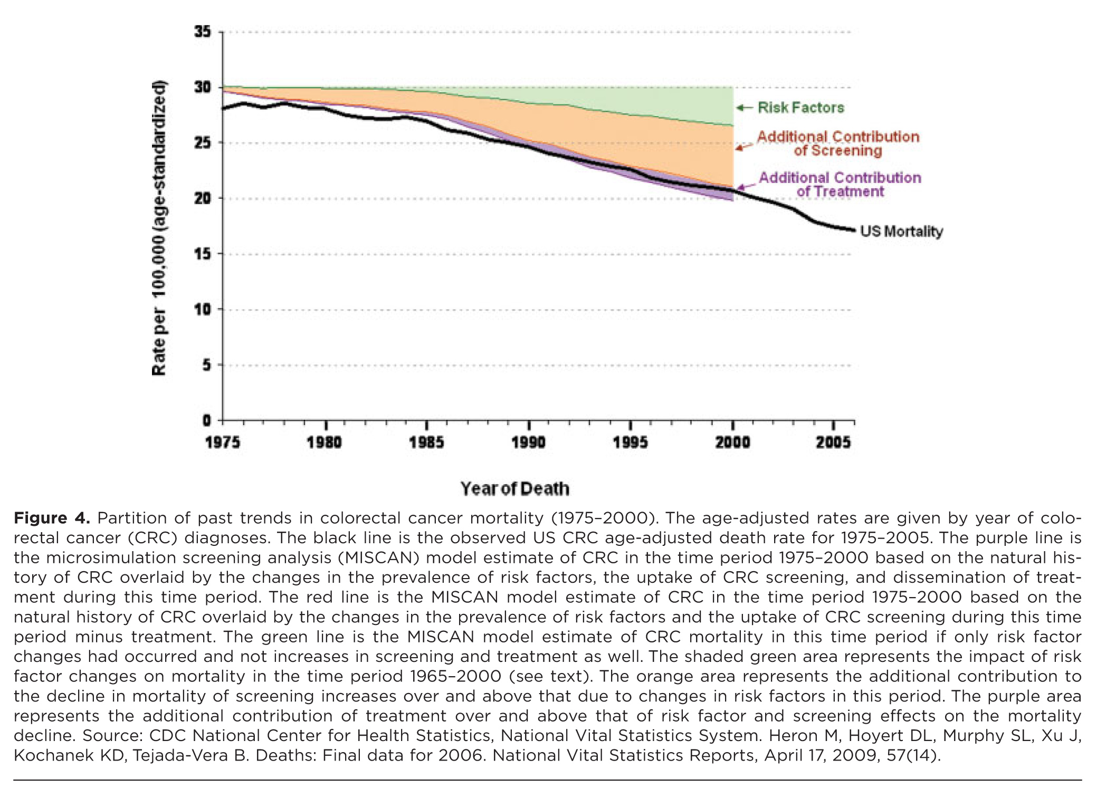
CRC Mortality

Slide 6
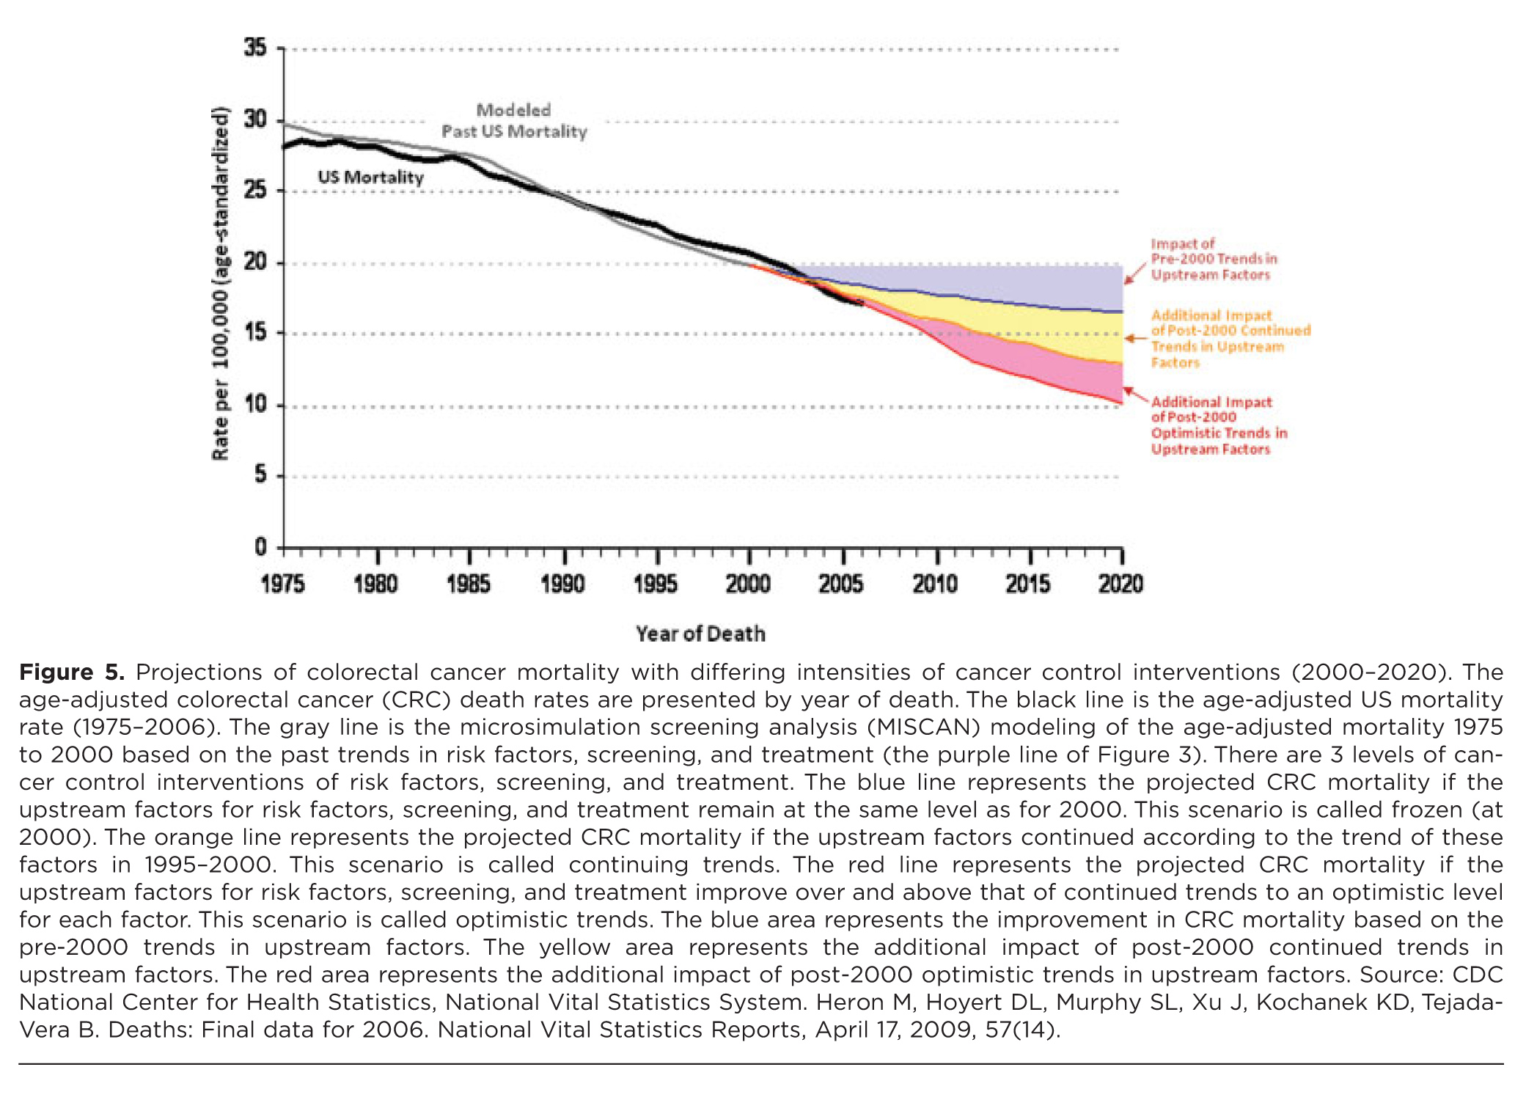
CRC Future Paths

Slide 7
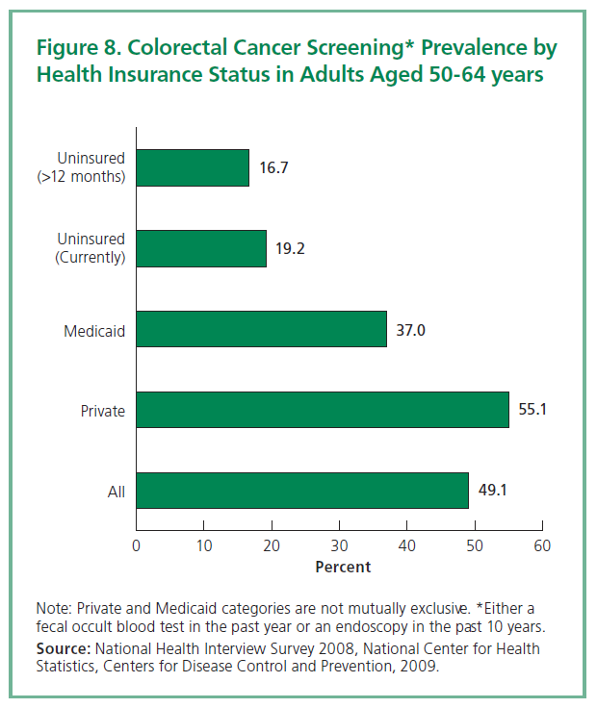

Slide 8
It’s about ACCESS, COST and Patient Education
Great and improving technology
Diagnostic tool compares favorably to those utilized in tools for cancer screening in other organ systems
Increased availability of high quality screening (dedicated ASCs and outpatient centers)
Stable/decreasing per-unit screening costs

