Slide 1
Welcome to ASCA’s Salary & Benefits Survey Benchmarking Portal Results Guide This guide outlines important information regarding the dynamic comparison, filtering and reporting features of the survey platform.

Slide 2
Comparison Data and Benchmarking Reports
Participants that complete 40% or more of the survey have FREE access to question-by-question comparisons and benchmarking reports.
Participants that did not complete 40% of the survey are presented with the option to purchase access to question-by-question comparisons and benchmarking reports.
If you have questions, please contact asc@ascassociation.org for additional support.

Slide 3
Main Menu
The Main Menu is the access point to navigate through all areas of the portal.
Tab and menu navigation
Enter Data is the tab used for answering all of the questions in the survey.
You can view your answers, but can no longer change them.
Compare Data is the tab used for comparing your answers to other participants on a question-by-question basis.
Run Reports is the tab used for downloading dynamic reports containing statistical charts and graphs.

Slide 4
Comparing ASCs
Click on the Compare Data tab to access question-by-question comparison data.
This menu looks similar to the “Enter Data” tab. Select any gray question group to view question-by-question comparisons
View on-demand popup charts by clicking on icon
For numeric questions, get popup charts by clicking on this icon:
For multiple choice questions, get popup charts by clicking on this icon:

Slide 5
Line Chart Legend
Understanding comparison results:
Multiple choice questions: View all answer options with their associated percentages. Your answers are indicated in blue.
Numeric questions: View a line chart displaying the 25th, median and 75th percentiles with your answer shown as a blue arrow above the line.

Slide 6
Filters
Filters have been specified for your platform to allow you to drill down in the data.
Select any filter or combination of filters to compare to a subset of data.
If your filter selection returns too few accounts, you will see this informational message:
Your filter settings are not currently active, because not enough accounts match the selection.
Results are currently displayed without filter settings.
Anonymity
By limiting the minimum number of accounts returned, it is impossible for account identity to be determined and anonymity of data is always protected.
If your filters do not return enough accounts, simply change your filter settings by:
Widening the range of a numeric filter
Turning off a filter by clicking on the X
Selecting a different filter option/combination of filter options

Slide 7
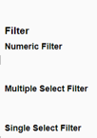
Using Filters
Click Edit to activate the filters.
Numeric filters: Click Add to activate sliders. Use slide bar to set a numeric range by moving the blue squares or enter a number in boxes.
Multi-select filters (if available): Check the items you wish to include.
Single-select filters (if available): Choose from the drop down menus.
Watch the filter message change as you select filters. A red warning message will display when you have filtered too far to return results.
If your filters do not return enough responses, change your filter settings by:
Widening the range of a numeric filter.
Turning off a numeric filter by clicking the X.
Returning a multiple choice filter to Any.
Click Clear to start over and select different filter options.
When you have the filter settings you desire, click Done to close the filter area.
Once you have found a filter setting that works for you, save it as a filter favorite to easily use again.

Slide 8
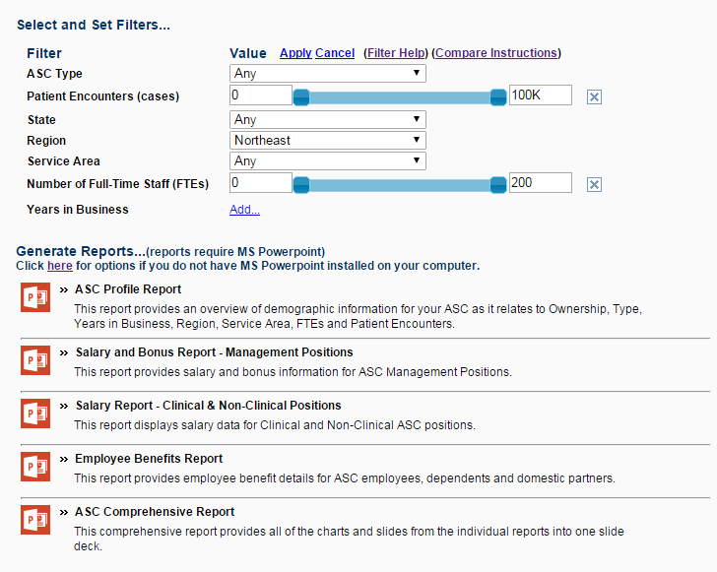
Reports
Click the Run Reports tab from the Main Menu
Choose from a list of downloadable PowerPoint reports that contain dynamically generated benchmarking charts.
Filter settings from Compare Data will carry over; however, they can easily be change or modified, if desired.
Dynamic Benchmarking
Reports can be quickly
downloaded, saved
to your computer and
used to prepare for
meetings, capture
historical snapshots
and share with others.

Slide 9
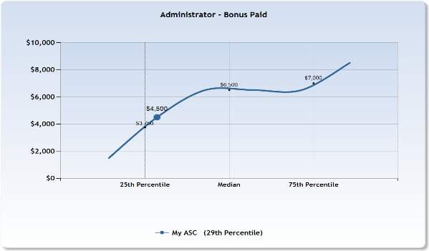
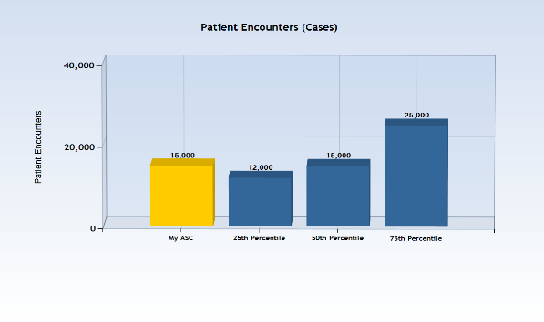
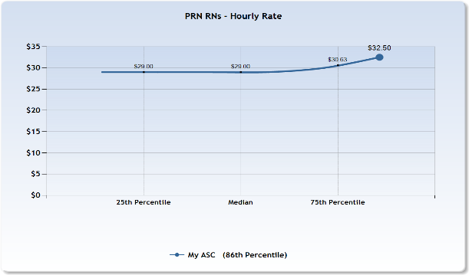
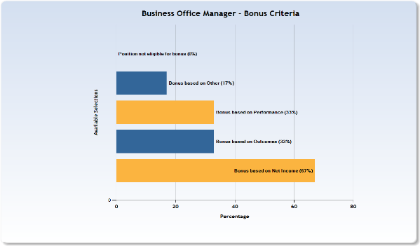
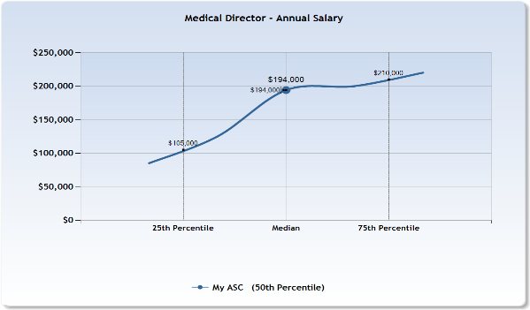
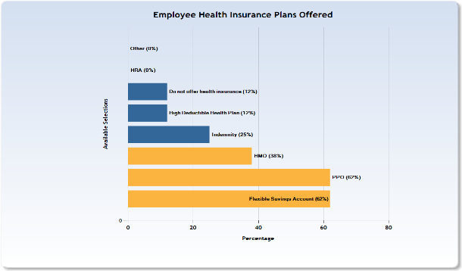
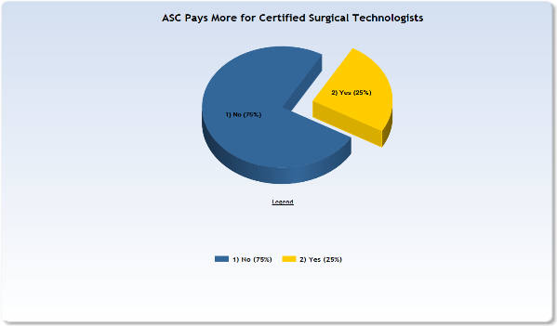
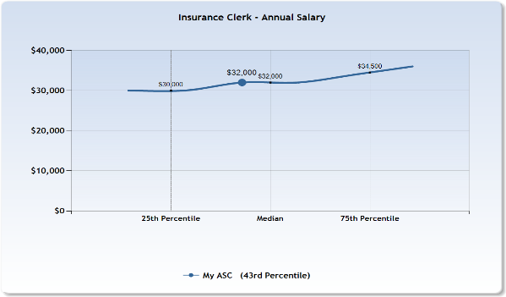
Sample Report Pages (note that all data displayed is sample data and not reflective of actual survey results)

Slide 10
Thank you for viewing this Results Guide. If you have further questions, please contact asc@ascassociation.org for additional support.

